Slide 1


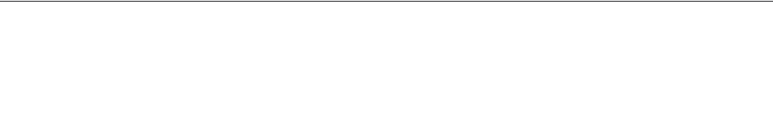
Deepfake Detection Using CNN
Major Project Progress Presentation (CA-481)
PRESENTATION BY
UNDER THE GUIDANCE OF
Joyganesh Barat (120710242004)
Prof. Anupam Baidya
Sayan Barat (120710242009)
Dept. of Computer Application, BCREC

Slide 2

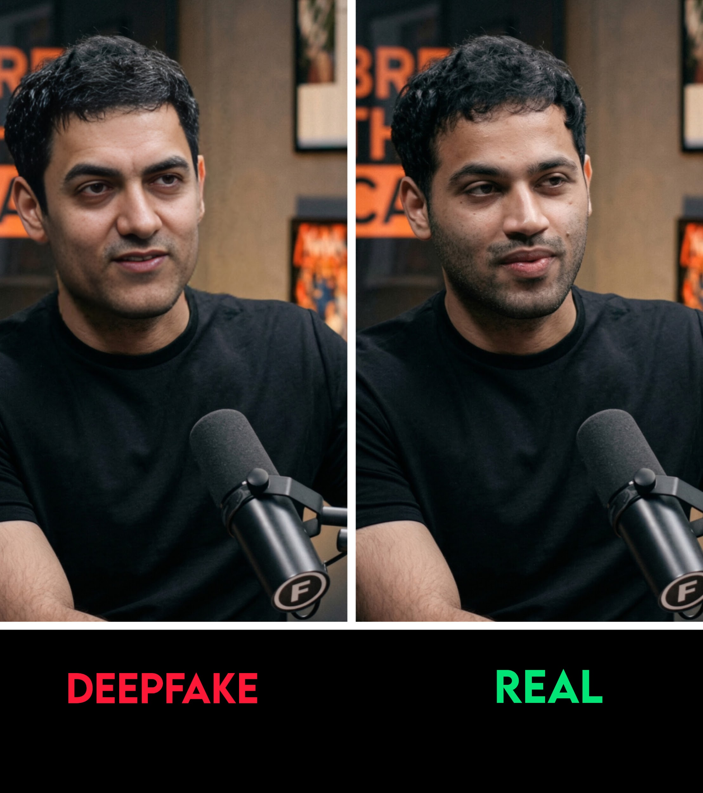
What is a Deepfake?
Deepfakes are synthetic media in which a person in an existing image or video is replaced with someone else's likeness using artificial neural networks.
They leverage advanced machine learning techniques like autoencoders and Generative Adversarial Networks (GANs) to create highly convincing but entirely fabricated footage.
While deepfakes have benign applications in entertainment and education, they pose significant societal threats by enabling the rapid spread of digital misinformation, identity theft, and fraudulent activities across the internet.

Slide 3


Project Overview
Objective & Technology
Mechanism & Interface
How it works: The pipeline extracts frames from a source video, employs Computer Vision algorithms to precisely detect and crop faces, processes these through our trained CNN model, and aggregates frame-level metrics for a final video prediction.
Primary Objective: To develop a robust, offline, deep learning system capable of detecting manipulated "deepfake" videos with exceptionally high accuracy.
Core Technology: We are utilizing the EfficientNet-B4 architecture integrated with transfer learning techniques to accurately classify individual video frames as either genuine or manipulated.
User Interface: A minimalist, entirely offline Flask web dashboard allowing end-users to upload media and receive real-time analyses, including confidence scores and visual heatmaps.

Slide 4




Module Specification
Data Preprocessing
Model Architecture
Handles raw video frame extraction and utilizes OpenCV for precise facial boundary detection and cropping (standardized to 224x224 pixels).
Implements the EfficientNet-B4 CNN backbone with a custom, fine-tuned classification head engineered specifically for real vs. fake binary classification.
Training Pipeline
Web Interface
Executes a two-phase training protocol (frozen backbone followed by deep fine-tuning) and dynamically generates evaluation metrics like Accuracy and ROC-AUC.
A responsive, Flask-driven dashboard offering seamless video upload capabilities, frame-by-frame analysis charts, and visual Grad-CAM heatmaps.

Slide 5




System Flow & Execution
4. Aggregation
2. Face Cropping
Frame probabilities are mathematically averaged to render a final video verdict, visualized alongside Grad-CAM heatmaps to highlight manipulation.
OpenCV scans extracted frames, intelligently detects facial boundaries, and crops the images to isolate the face for targeted CNN analysis.
1. Input & Extraction
3. Classification
User uploads a target .mp4 video via the Web UI. The system immediately parses it and extracts visual frames at specified, optimized intervals.
Processed faces are fed chronologically into the trained EfficientNet-B4 neural network to compute a distinct "fake probability" per frame.

Slide 6
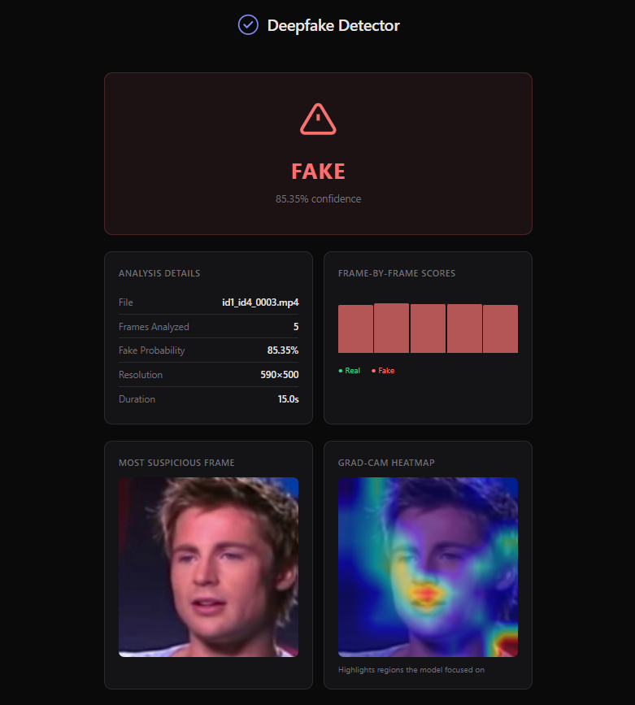
Recent Work Progress
Initial Setup Completed Project structure established, virtual environments active, and all deep learning dependencies firmly configured.
Web Interface Built The minimal dark-theme Flask application covering the core upload and analytics result pages has been fully integrated.
Data Pipeline Finalized We have engineered resilient scripts (`data_preprocessing.py`) handling automated data ingestion and precise face cropping.
Model Logic Implemented The EfficientNet-B4 architecture (`model.py`) and corresponding local inference loops (`predict.py`) are successfully coded and currently undergoing fine-tuning.

Slide 7

Conclusion & Future Scope
Foundation Established: We have successfully laid the technical groundwork for an efficient, fully offline deepfake detection system. The data extraction protocols and core web UI modules are actively functional.
Immediate Next Steps: We are transitioning to complete full-scale model training leveraging benchmark datasets (such as FaceForensics++ or Celeb-DF) and will subsequently generate detailed evaluation matrices including ROC curves.
Ultimate Goal: To deploy a highly accurate, lightweight, and explainable software tool capable of actively combating digital misinformation without relying on compromised third-party cloud APIs.

